Slide 1
Data Representation
CT101 – Computing Systems

Slide 2
Computing Systems Data
Usually the computing systems are complex devices, dealing with a vast array of information categories
The computing systems store, present, and help us modify:
  Text
  Audio
  Images and graphics
  Video

Slide 3
Digital vs. Analog (1)
Computing systems are finite machines. They store a limited amount of information, even if the limit is very big.
  The goal, is to represent enough of the world to satisfy our computational needs and our senses of sight and sound.
The information can be represented in one or two ways: analog or digital.
  Analog data is a continuous representation, analogous to the actual information it represents.
    In example, a mercury thermometer is an analog device. The mercury rises in a continuous flow in the tube in direct proportion to the temperature.
  Digital data is a discrete representation, breaking the information up into separate (discrete) elements.
    Computers can’t work with analog information, so a need do digitize the analog information arise.
    This is done by breaking the analog information into pieces and representing those pieces using binary digits

Slide 4
Digital vs. Analog (2)
Why digital signal?
  Both electronic signals (analog and digital) degrade as they move down a line. The voltage of the signal fluctuates due to environmental effects.
  As soon as an analog signal degrades, information is lost. Since any voltage level within the range is valid, it is impossible to know that the original signal was even changed
  Digital signals jump sharply between two extremes (high and low state). A digital signal can degrade quite a bit until the information is lost, because any value over a certain threshold is considered high value and bellow the threshold is considered low value
Answer: Signal Integrity can be maintained!

Slide 5
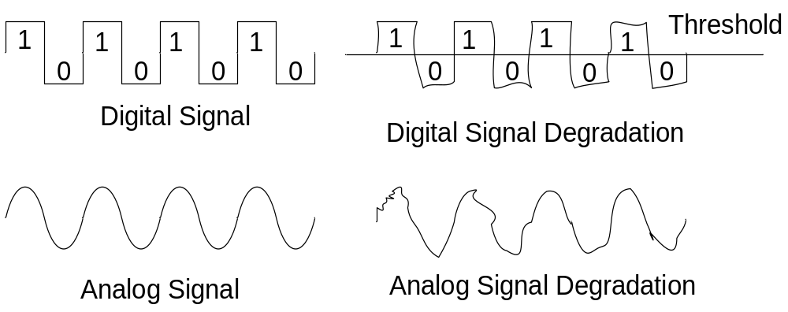
Digital vs. Analog (3)
You can still retrieve the information from a reasonably degraded digital signal
Periodically a digital signal is reclocked to regain its original shape. As long as it is reclocked before too much degradation, no info is lost.

Slide 6
Binary Representation (1)
Why binary representation (as suppose to decimal or octal, etc..)?
  Because the devices that store and manage the digital data are far less expensive and complex for binary representation.
  They are also far more reliable when they have to represent one out of two possible values.
  Because the electronic signals are easier to maintain if they carry only binary data.

Slide 7
Binary Representation (2)
One bit can be either 0 or 1. Therefore, one bit can represent only two things.
To represent more than two things, we need multiple bits. Two bits can represent four things because there are four combinations of 0 and 1 that can be made from two bits: 00, 01, 10,11.
In general, n bits can represent 2^{n} things because there are 2^{n} combinations of 0 and 1 that can be made from n bits. Note that every time we increase the number of bits by 1, we double the number of things we can represent.

Slide 8
Data Formats - How to Interpret Data
Meaning of internal representation must be appropriate for the type of processing to take place:
  i.e. Images & sound: have to be digitized
    Images – need detailed description of the data, how color is represented at each data point
    Sound – need sampling rate
Proprietary formats
  Unique to a product or company
  E.g., Microsoft Word, Corel Word Perfect, IBM Lotus Notes
Standards
  Evolve two ways:
    Proprietary formats become de facto standards (e.g., Adobe PostScript, Apple Quick Time)
    Committee is struck to solve a problem (Motion Pictures Experts Group, MPEG)

Slide 9
Why Standards?
They exist because they are:
  Convenient – sometimes the time to market is very important whenever trying to finish a product, therefore existing standards may be used to save time elaborating own protocols and interfaces
  Efficient – most of the standards are put together by committees with a wide experience in the specific area
  Flexible – usually the standards allow for manufacturer or OEM specific extensions
  Appropriate – address a specific problem in a specific domain
Allow communication and sharing of information
Allow computing systems and software to interoperate (at both hardware and software levels)
Sometimes standards are arbitrary and have some “blast from the past” (due to historical evolution)

Slide 10
Standards Organizations
ISO – International Standards Organization
IEEE – Institute for Electrical and Electronics Engineers
CSA – Canadian Standards Association
ANSI – American National Standards Institute
NSAI – National Standards Authority of Ireland

Slide 11
Examples of Standards
Type of Data | Standards
Alphanumeric | ASCII, Unicode
Image | JPEG, GIF, PCX, TIFF, BMP, etc
Motion picture | MPEG-2, MPEG-4, etc
Sound | WAV, AU, MP3, etc..
Outline graphics/fonts | PostScript, TrueType, PDF

Slide 12
Alphanumeric Data
Three standards for representing letters (alpha) and numbers
  ASCII – American Standard Code for Information Interchange
  EBCDIC – Extended Binary-Coded Decimal Interchange Code (not used anymore, used to be used in IBM mainframes)
  Unicode

Slide 13
Codes and Characters
The problem:
  Representing text strings, such as
  “Hello, world”, in a computer
Each character is coded as a byte ( = 8 bits)
Most common coding system is ASCII
ASCII = American National Standard Code for Information Interchange
Defined in ANSI document X3.4-1977

Slide 14
ASCII Features
7-bit code
8th bit is unused (or used for a parity bit)
2⁷ = 128 codes
Two general types of codes:
  95 are “Graphic” codes (displayable on a console)
  33 are “Control” codes (control features of the console or communications channel)

Slide 15
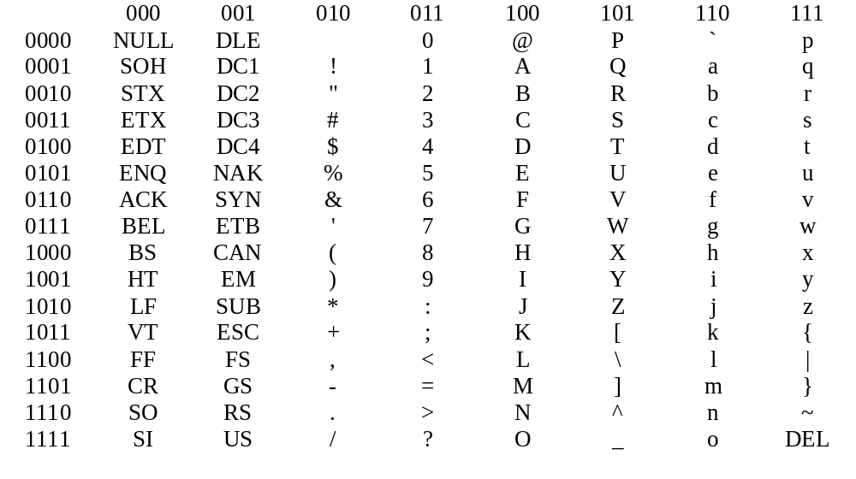
Most significant bit
Least significant bit

Slide 16
i.e. ‘a’ = 1100001₂ = 97₁₀ = 61₁₆

Slide 17
95 Graphic codes

Slide 18
33 Control codes

Slide 19
Alphabetic codes

Slide 20
“Hello, world” Example
H
e
l
l
o
,
w
o
r
l
d
=
=
=
=
=
=
=
=
=
=
=
=
Binary
01001000
01100101
01101100
01101100
01101111
00101100
00100000
01110111
01101111
01110010
01101100
01100100
=
=
=
=
=
=
=
=
=
=
=
=
Hexadecimal
48
65
6C
6C
6F
2C
20
77
6F
72
6C
64
=
=
=
=
=
=
=
=
=
=
=
=
Decimal
72
101
108
108
111
44
32
119
111
114
108
100
Note: 12 characters – requires 12 bytes
Each character requires 1 byte

Slide 21
Numeric codes

Slide 22
“4+15” Example
=
=
=
=
Binary
00110100
00101011
00110001
00110101
=
=
=
=
Hexadecimal
34
2B
31
35
=
=
=
=
Decimal
52
43
49
53
4
+
l
5
“4+15” is represented as
“00110100 00101011 00110001 00110101”
or “34₁₆2B₁₆31₁₆35₁₆”

Slide 23
Punctuation, etc.

Slide 24
Common Control Codes
CR 0D carriage return
LF 0A line feed
HT 09 horizontal tab
DEL 7F delete
NULL 00 null

Slide 26
Escape Sequences
Extend the capability of the ASCII code set
For controlling terminals and formatting output
Defined by ANSI in documents X3.41-1974 and X3.64-1977
The escape code is ESC = 1B₁₆
An escape sequence begins with two codes:
Example:
  Erase display: ESC [ 2 J
  Erase line: ESC [ K
ESC
[
1B₁₆
5B₁₆

Slide 27
Unicode (1)
The extended version of the ASCII character set is not enough for international use.
The Unicode character set uses 16 bits per character. Therefore, the Unicode character set can represent 2¹⁶, or over 65 thousand, characters.
Unicode was designed to be a superset of ASCII. That is, the first 256 characters in the Unicode character set correspond exactly to the extended ASCII character set.

Slide 28

Unicode (2)
Version 2.1
  1998
  Improves on version 2.0
  Includes the Euro sign (20AC₁₆ = )
  From the standard:
    …contains 38,887 distinct coded characters derived from the supported scripts. These characters cover the principal written languages of the Americas, Europe, the Middle East, Africa, India, Asia, and Pacifica.
Latest version of Unicode is 4.0
http://www.unicode.org

Slide 29
Audio Information Representation (1)
Sound is perceived when a series of air compressions vibrate a membrane in our ear, which sends signals to our brain
A stereo sends an electrical signal to a speaker to produce sound. This signal is an analog representation of the sound wave. The voltage in the signal varies in direct proportion to the sound wave
To digitize the signal we periodically measure the voltage of the signal and record the appropriate numeric value. The process is called sampling
In general, a sampling rate of around 40,000 times per second is enough to create a very good high quality sound reproduction

Slide 30
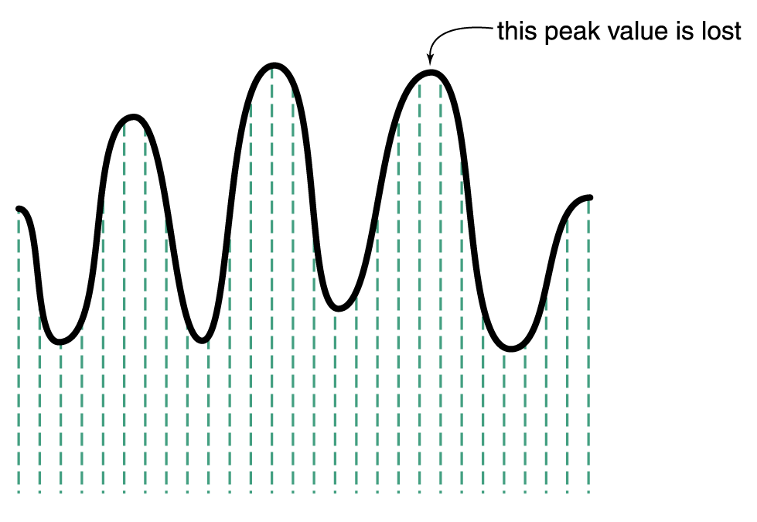
Audio Information Representation (2)
Sampling an audio signal

Slide 31
Audio Formats
Several popular formats are: WAV, AU, AIFF, VQF, and MP3. Currently, the dominant format for compressing audio data is MP3.
MP3 is short for MPEG-2, audio layer 3 file.
Compressed formats usually employ both lossy and lossless compression.
  Analyzes the frequency spread and compares it to mathematical models of human psychoacoustics (the study of the interrelation between the ear and the brain) and it discards information that can’t be heard by humans.
  Then the bit stream is compressed using a form of Huffman encoding to achieve additional compression.

Slide 32
Representing Images and Graphics (1)
Color is our perception of the various frequencies of light that reach the retinas of our eyes
Our retinas have three types of color photoreceptor cone cells that respond to different sets of frequencies.
  These photoreceptor categories correspond to the colors of red, green, and blue
Color is often expressed in a computer as an RGB (red-green-blue) value, which is actually three numbers that indicate the relative contribution of each of these three primary colors
For example, an RGB value of (255, 255, 0) maximizes the contribution of red and green, and minimizes the contribution of blue, which results in a bright yellow

Slide 33
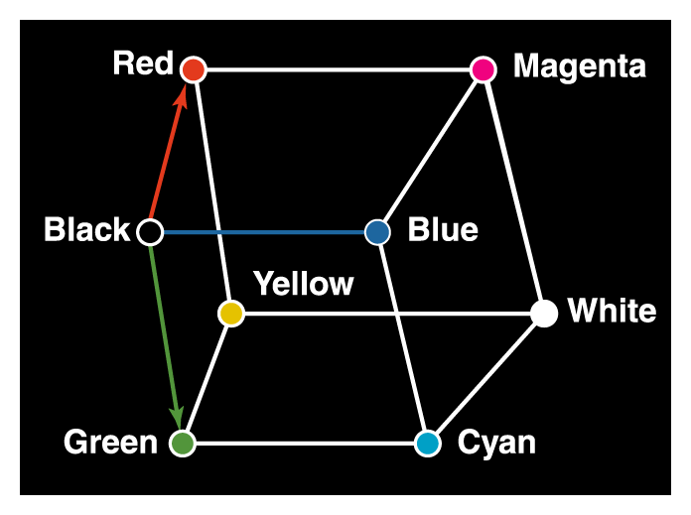
Representing Images and Graphics (2)
Three-dimensional color space

Slide 34
Representing Images and Graphics (3)
The amount of data that is used to represent a color is called the color depth.
HiColor is a term that indicates a 16-bit color depth.
  Five bits are used for representing the R and B components.
  Six bits are used for representing the G component, because the human eye is more sensitive to G;
TrueColor indicates a 24-bit color depth. Therefore, each number in an RGB value is represented using eight bits.

Slide 35
Representing Images and Graphics (4)
RGB Value |  |  | Color
Red | Green | Blue
0 | 0 | 0 | black
255 | 255 | 255 | white
255 | 255 | 0 | yellow
255 | 130 | 255 | Pink
146 | 81 | 0 | brown
157 | 95 | 82 | purple
140 | 0 | 0 | maroon

Slide 36
Digitized Images and Graphics
Digitizing a picture is the act of representing it as a collection of individual dots called pixels.
The number of pixels used to represent a picture is called the resolution.
The storage of image information on a pixel-by-pixel basis is called a raster-graphics format.
  Several popular raster file formats including bitmap (BMP), GIF, and JPEG.

Slide 37
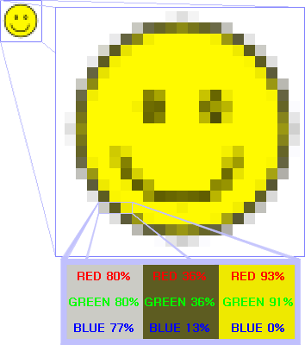
BMP Raster Image Example
The smiley face in the top left corner is a bitmap image.
When enlarged, individual pixels appear as squares.
Each pixel is described by a value for red, green and blue.

Slide 38
Vector Graphics
Instead of assigning colors to pixels as we do in raster graphics, a vector-graphics format describe an image in terms of lines and geometric shapes.
  A vector graphic is a series of commands that describe a line’s direction, thickness, and color. The file size for these formats tend to be small because every pixel does not have to be accounted for.
Vector graphics can be resized mathematically, and these changes can be calculated dynamically as needed.
However, vector graphics is not good for representing real-world images.

Slide 39
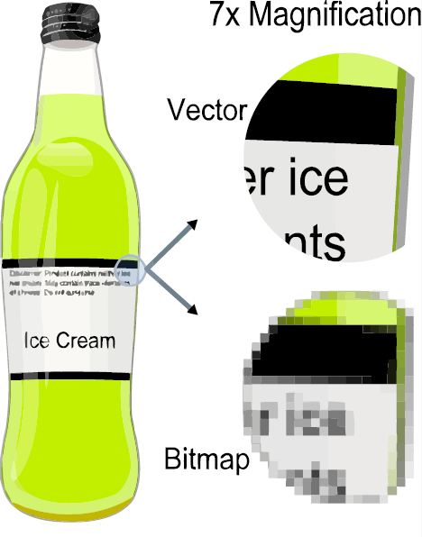
Example of Vector Image
Effect of vector graphics versus raster graphics.
Magnification of 7x as a vector image vs same magnification as a bitmap image.
Examples of vector image formats: SVG (Scalable Vector Graphics), EPS (Encapsulated Post Script), etc..

Slide 40
Video
What is video?
  is the technology of electronically capturing, recording, processing, storing, transmitting and reconstruction a sequence of still images representing scenes in motion
  It is a collection of still images
How does video camera work?
  lens of the camera focuses an image onto a sensor, and the sensor converts the image into an electronic signal that is stored on tape, disc, hard-drive, or memory card (in a compressed or raw format).
What about sound?
  Video cameras usually record sound along with images. Almost all video cameras have microphones, but even though images and sound are usually recorded to the same tape, disc, or card they are two different types of information - so sometimes it helps to think of them separately.
  You might record a beautiful visual scene with terrible noise, but you know that you won’t use the sound. Or you might record some beautiful sound with your video camera while the lens cap is on because you just want the sound.

Slide 41
Representing Video
Frame rate: the number of still images (or frames) recorded every second.
  Usually frame rate is expressed in frames per second (fps) and most video cameras record at 30 fps.
Resolution: how many pixels the image has.
  Resolution is usually expressed by numbers for horizontal and vertical: 640 by 480 means 640 pixels wide, by 480 pixels tall.
  Multiply the numbers and you get the total number of pixels. In this case 640x480 = 307,200.
Aspect Ratio: what defines the width and height of your images.
  The most common aspect ratios are 3:2, 4:3, and 16:9.
Compression and Format: to save space the movie gets compressed to make it smaller.
  The way a camera compresses the image data and records it is the recording format.

Slide 42
Representing Video
A video codec Compressor/De-compressor refers to the methods used to shrink the size of a movie
  Almost all video codecs use lossy compression to minimize the huge amounts of data associated with video.
Two types of compression: temporal and spatial.
Temporal compression looks for differences between consecutive frames. If most of an image in two frames hasn’t changed, why should we waste space to duplicate all of the similar information?
Spatial compression removes redundant information within a frame.
  For instance, a line compression algorithm, instead of representing a white line as a series of dots with individual color info, it can represent it as how many dots of white color (saving storage space)
  This problem is essentially the same as that faced when compressing still images.

Slide 43

Question
Given a video with a 16x12 resolution and 30 fps, what would be the physical storing space in raw RGB16 format (16 bits per pixel) for 1 second of video:

Slide 44
Data Compression
It is important that data be represented efficiently for two reasons: store and transmission
For now we will study some common text compression techniques:
  keyword encoding
  run-length encoding
  Huffman encoding
  Arithmetic(Binary and Decimal encoding)
  LWZ etc

Slide 45
Keyword Encoding
Frequently used words are replaced with a single character. For example:
Word | Symbol
as | ^
the | ~
and | +
that | $
must | &
well | %
those | #

Slide 46
Keyword Encoding
The following paragraph:
  The human body is composed of many independent systems, such as the circulatory system, the respiratory system, and the reproductive system. Not only must all systems work independently, they must interact and cooperate as well. Overall health is a function of the well-being of separate systems, as well as how these separate systems work in concert.

Slide 47
Keyword Encoding
The encoded paragraph is:
  The human body is composed of many independent systems, such ^ ~ circulatory system, ~ respiratory system, + ~ reproductive system. Not only & each system work independently, they & interact + cooperate ^ %. Overall health is a function of ~ %- being of separate systems, ^ % ^ how # separate systems work in concert.

Slide 48
Keyword Encoding
Thee are a total of 349 characters in the original paragraph including spaces and punctuation. The encoded paragraph contains 314 characters, resulting in a savings of 35 characters. The compression ratio for this example is 314/349 or approximately 0.9.
The characters we use to encode cannot be part of the original text.

Slide 49
Run-Length Encoding
A single character may be repeated over and over again in a long sequence. This type of repetition doesn’t generally take place in English text, but often occurs in large data streams.
In run-length encoding, a sequence of repeated characters is replaced by a flag character, followed by the repeated character, followed by a single digit that indicates how many times the character is repeated.

Slide 50
Run-Length Encoding
AAAAAAA would be encoded as: *A7
*n5*x9ccc*h6 some other text *k8eee would be decoded into the following original text:
nnnnnxxxxxxxxxccchhhhhh some other text kkkkkkkkeee
The original text contains 51 characters, and the encoded string contains 35 characters, giving us a compression ratio in this example of 35/51 or approximately 0.68.
Since we are using one character for the repetition count, it seems that we can’t encode repetition lengths greater than nine. Instead of interpreting the count character as an ASCII digit, we could interpret it as a binary number.

Slide 51
Huffman Encoding (1)
Why should the character “X”, which is seldom used in text, take up the same number of bits as the blank, which is used very frequently?
  Huffman codes using variable-length bit strings to represent each character.
A few characters may be represented by five bits, and another few by six bits, and yet another few by seven bits, and so forth.
If we use only a few bits to represent characters that appear often and reserve longer bit strings for characters that don’t appear often, the overall size of the document being represented is small

Slide 52
Huffman Encoding (2)
Huffman code | Character
00 | A
01 | E
100 | L
110 | O
111 | R
1010 | B
1011 | D
Consider the following Huffman codes:
Notes:
An important characteristic of any Huffman encoding is that no bit string used to represent a character is the prefix of any other bit string used to represent a character.

Slide 53
Huffman Encoding (3)
DOORBELL would be encode in binary as: 1011 110 110 111 1010 01 100 100.
  If we used a fixed-size bit string to represent each character (say, 8 bits), then the binary form of the original string would be 64 bits.
  The Huffman encoding for that string is 25 bits long, giving a compression ratio of 25/64, or approximately 0.39.
An important characteristic of any Huffman encoding is that no bit string used to represent a character is the prefix of any other bit string used to represent a character.

Slide 54
Review Question 9
Two compression algorithms ALGO1 and ALGO2 produce a compression ratio of 0.8 and respectively 0.5. Which statement is correct?
ALGO1 is better than ALGO2
ALGO2 is better than ALGO1
No algorithm is good
I don’t know
Both algorithms are good

Slide 55
Review Question 10
Consider the run length encoding. Consider that instead of interpreting the count character as an ASCII digit we interpret it as a binary number. How many maximum characters can we encode?
128
256
65536
I don’t know …

